Slide 1
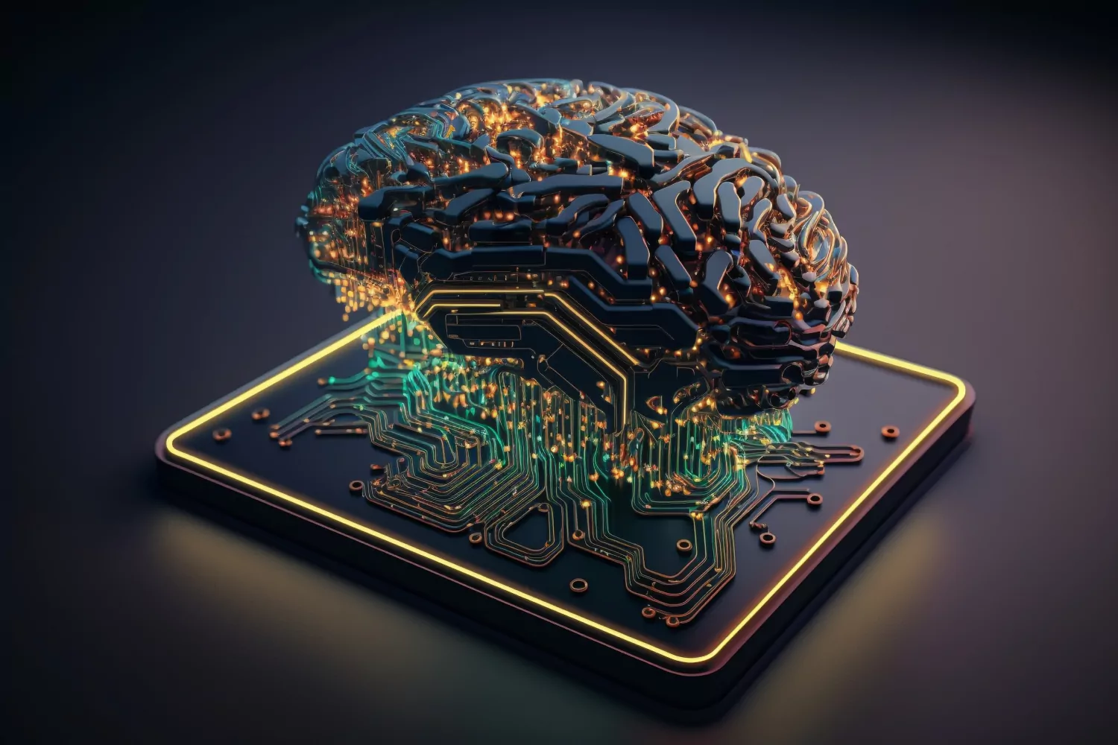
Deep Learning
By: Miguelangel Sanchez-Yevenes

Slide 2
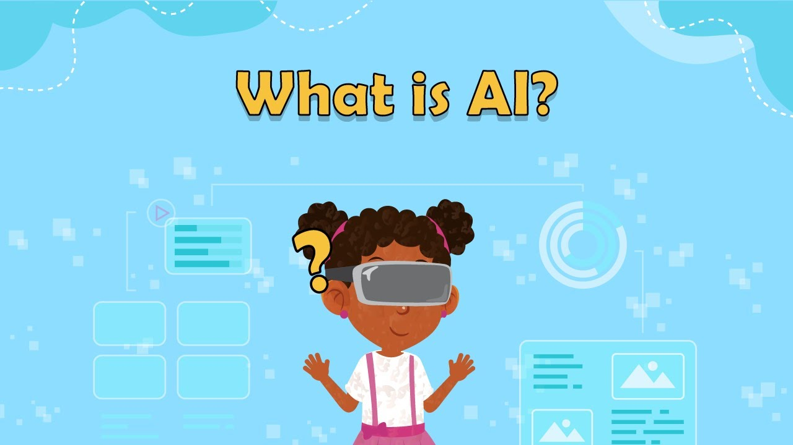
Artificial Intelligence
What is Artificial Intelligence? - Artificial Intelligence (or known as AI) creates computer systems that can think, learn, and make decisions similar to how humans learn. -You may have seen a lot such as chatbots on apps or doctor websites There are many common terms that people use around AI and one of them is Deep Learning.

Slide 3

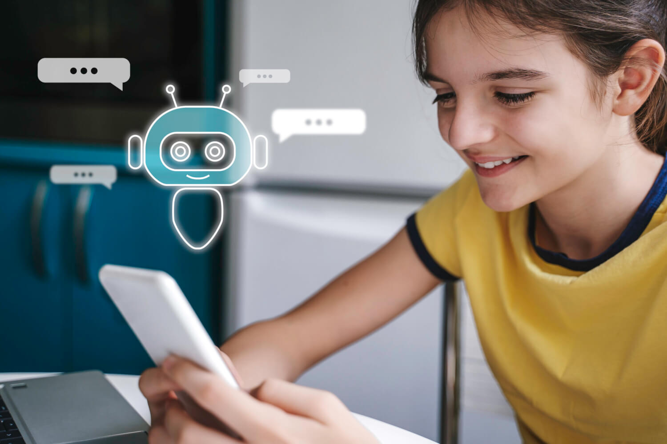
Example of AI
In the game Smash Bros for the Wii u and above, you use amiibos. When you first go against them, they are level 1 and bad. The more you play and train, they gain exp and level up by getting smarter and using more tactics against you. Always remember, Artificial Intelligence is when computers are able to learn, think, and make decisions like humans (but not perfectly)

Slide 4
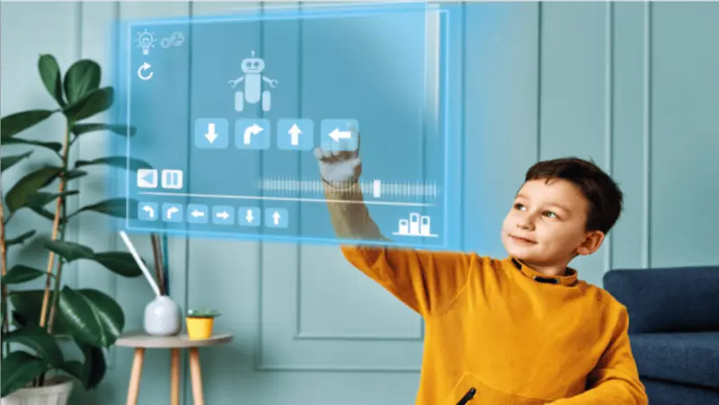
Deep Learning
Deep Learning is a method of machine learning that lets computers learn in a way that copies a human brain. It’s neurons are put into categories of layers, Input, Hidden and Output Input Layer: Data enters Hidden Layer: Transforms and analyze Output Layer: Makes predictions/decisions

Slide 5
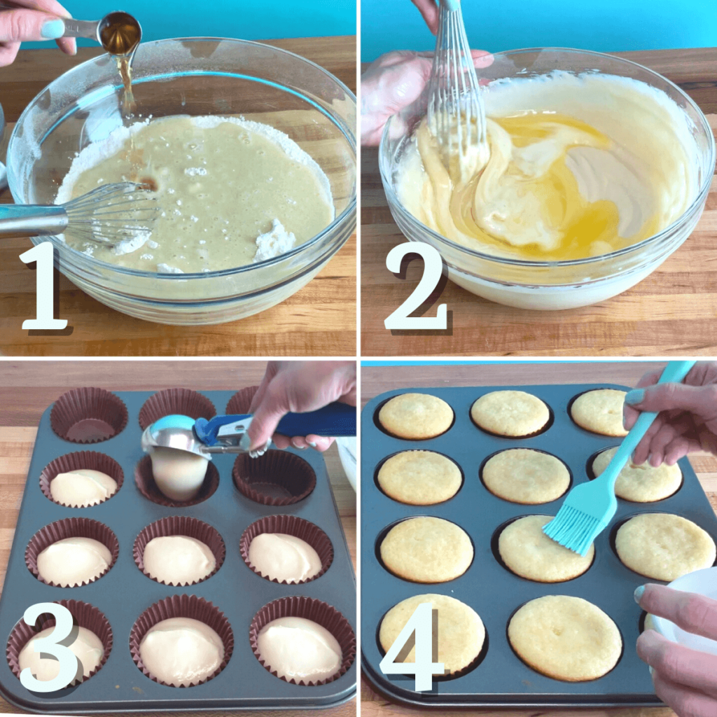

Deep Learning Examples
Think about learning to recognize a cupcake, Before, you never knew what made it a cupcake. Since you have no knowledge and recognition of it. Then you start to see many cupcakes like in the grocery store, birthday parties, etc. Your brain now learns what makes a cupcake, a cupcake. Which starts the Deep learning of layers It has frosting It has a wrapping Its small Deep Learning is when a computer learns from lots and lots of data using layers (like a brain) to get smarter.

Slide 6

Backpropagation
This method is when the neural networks learn from their mistakes, calculating their errors and sending it back to the network to make it accurate over time.
Ex: let's say you threw a basketball and missed. you think to yourself were you far, too close, etc. Then you change positions and try again until you make the shot.
In other words, you send the mistakes back in order to improve

Slide 7
Resources
https://www.heinz.cmu.edu/media/2023/July/artificial-intelligence-explained https://www.ibm.com/think/topics/deep-learning#:~:text=By%20Dave%20Bergmann,learning's%20incredible%20power%20and%20versatility. https://www.geeksforgeeks.org/machine-learning/backpropagation-in-neural-network/

